Slide 1
ETL

Slide 2
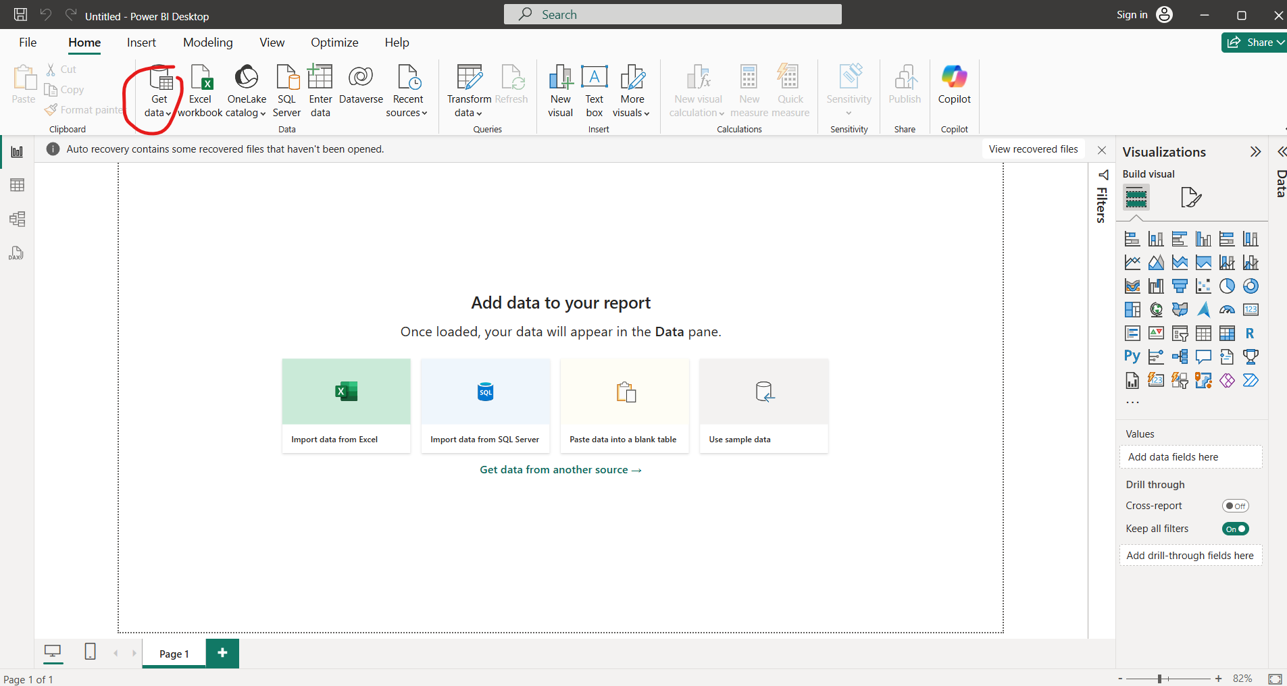
Open Power BI

Slide 3
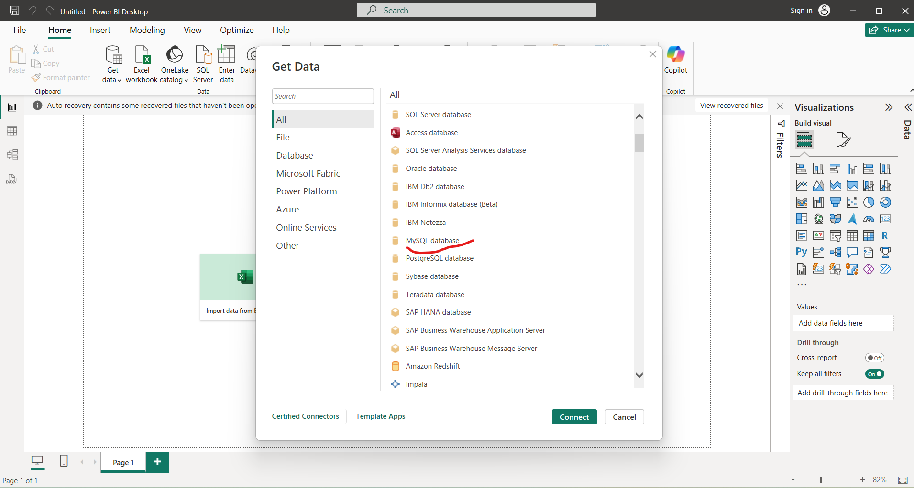
Click on more and select “Mysql database”

Slide 4
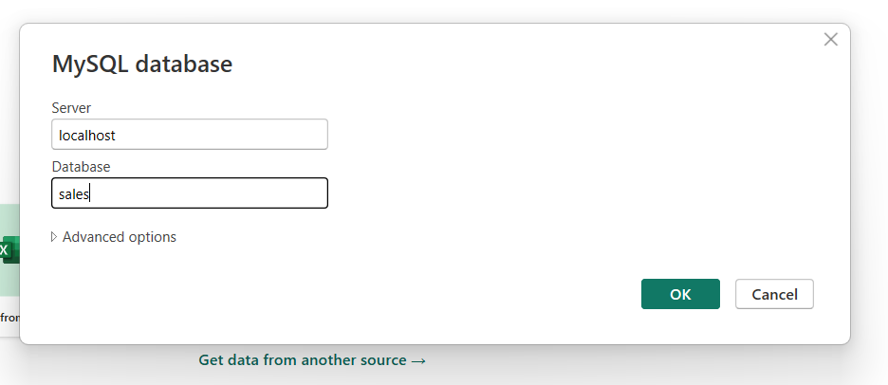
Give localhost and your sql DB name

Slide 5
Some times you are asked to provide user name=root and Password= root (or leave blank)

Slide 6
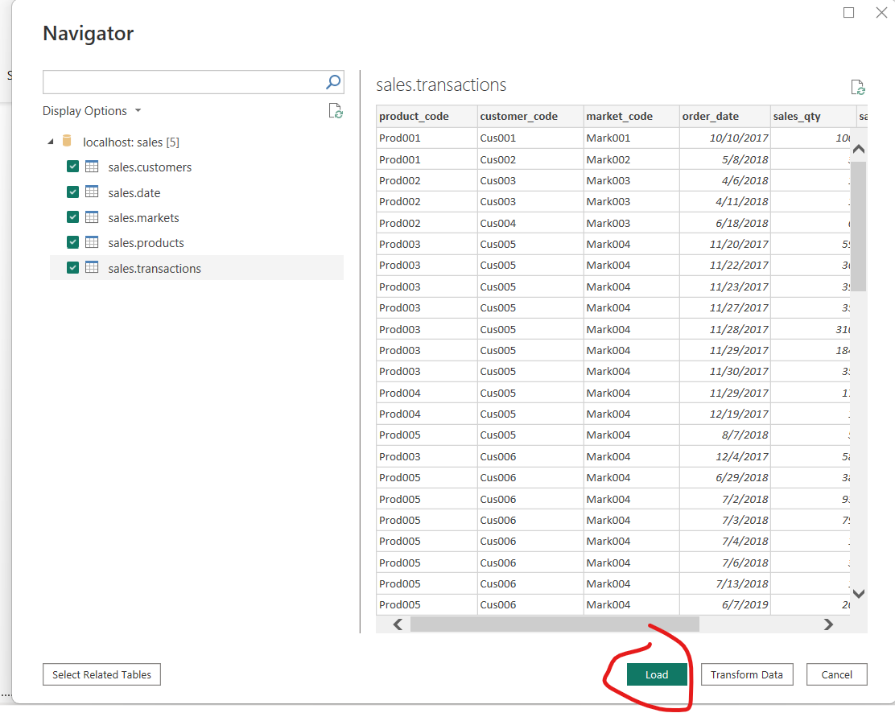
Load the data

Slide 7
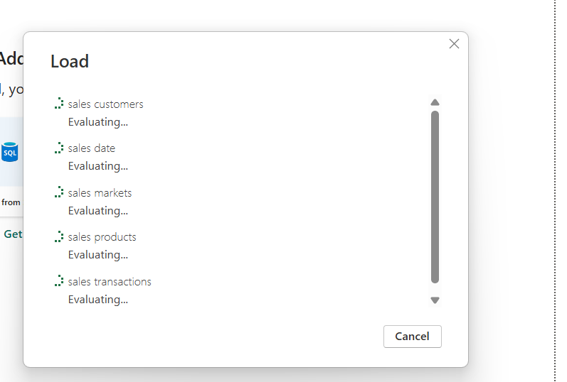
Loading Starts

Slide 8
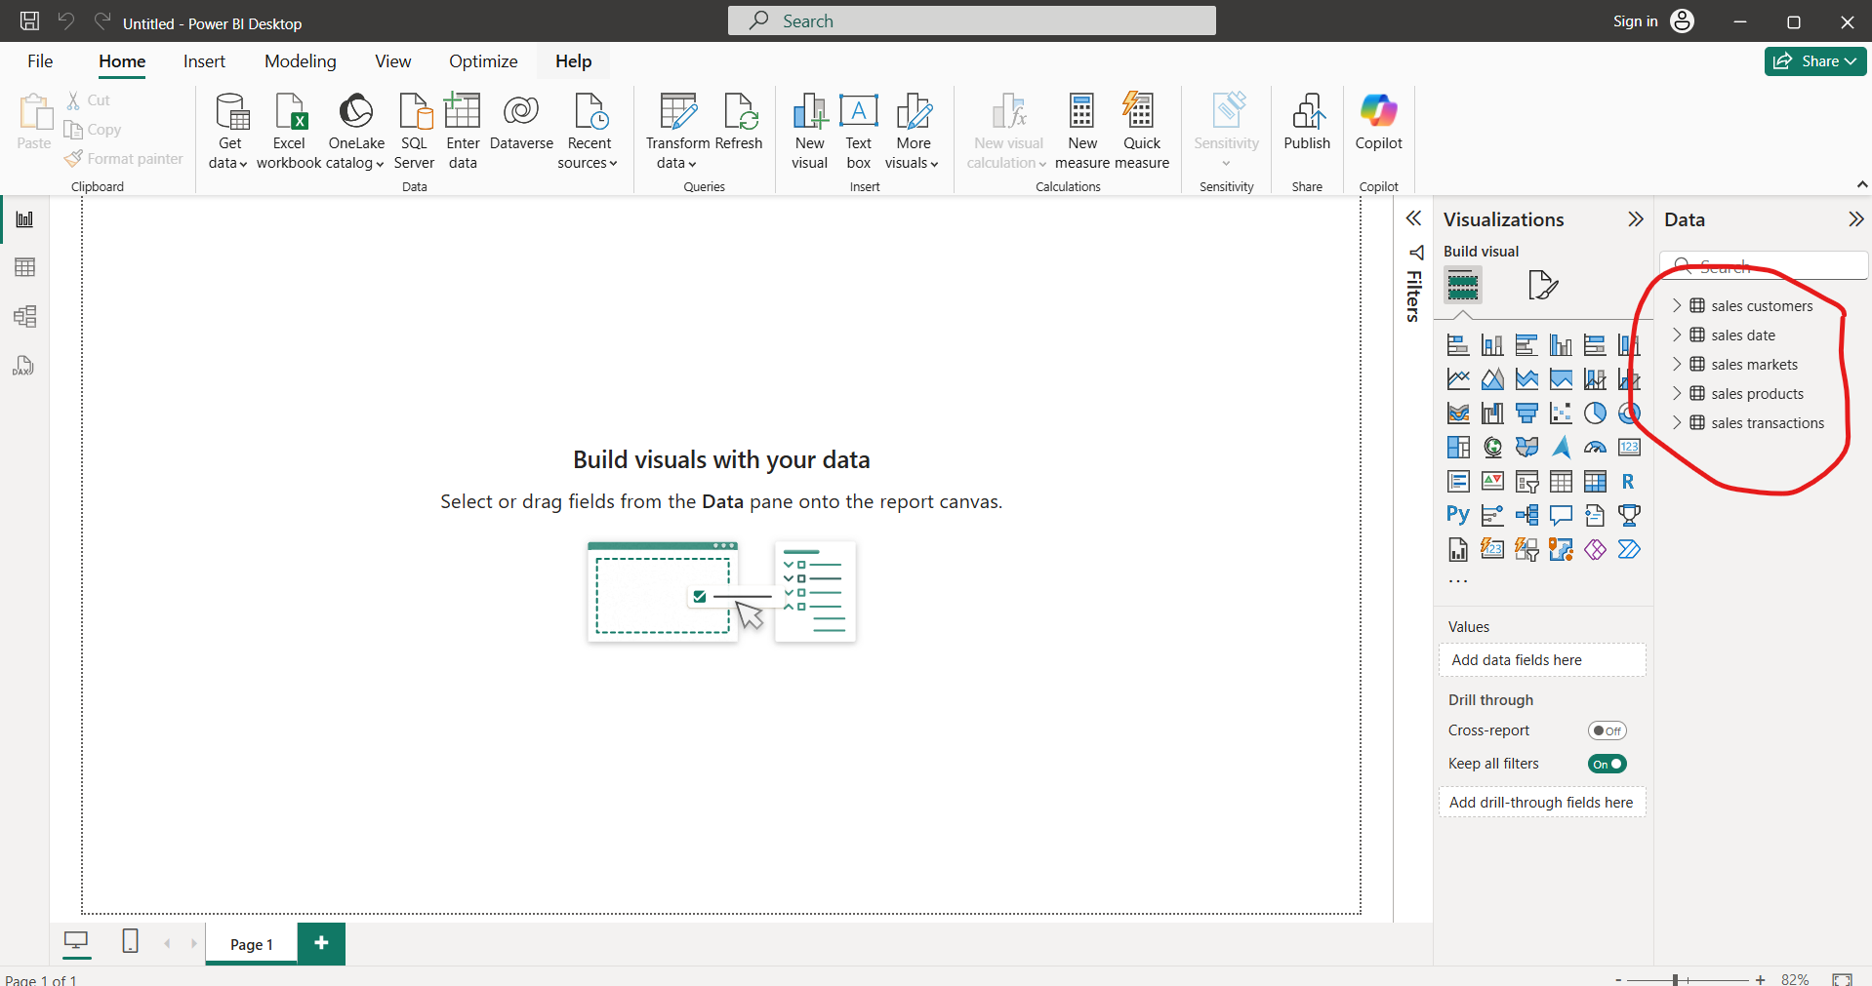
Data been Loaded and visible on power BI report view

Slide 9
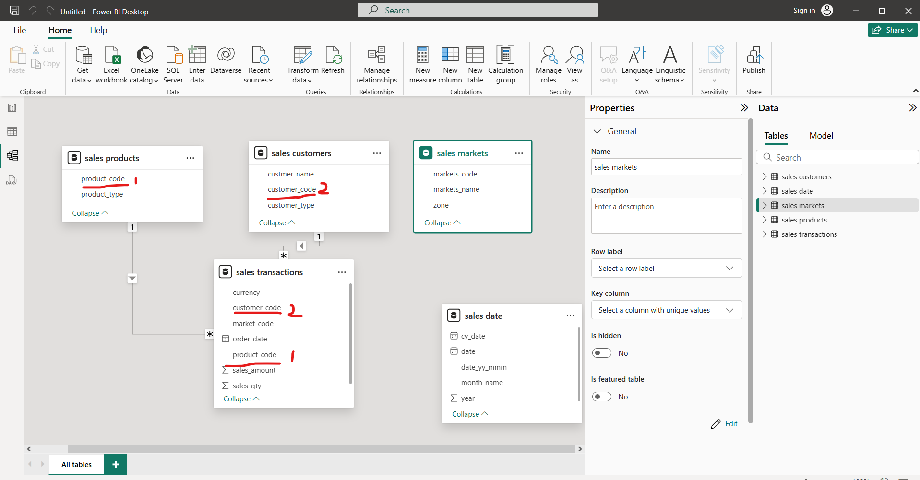
If we goto model view of power BI we can spot relational schema based on common columns

Slide 11
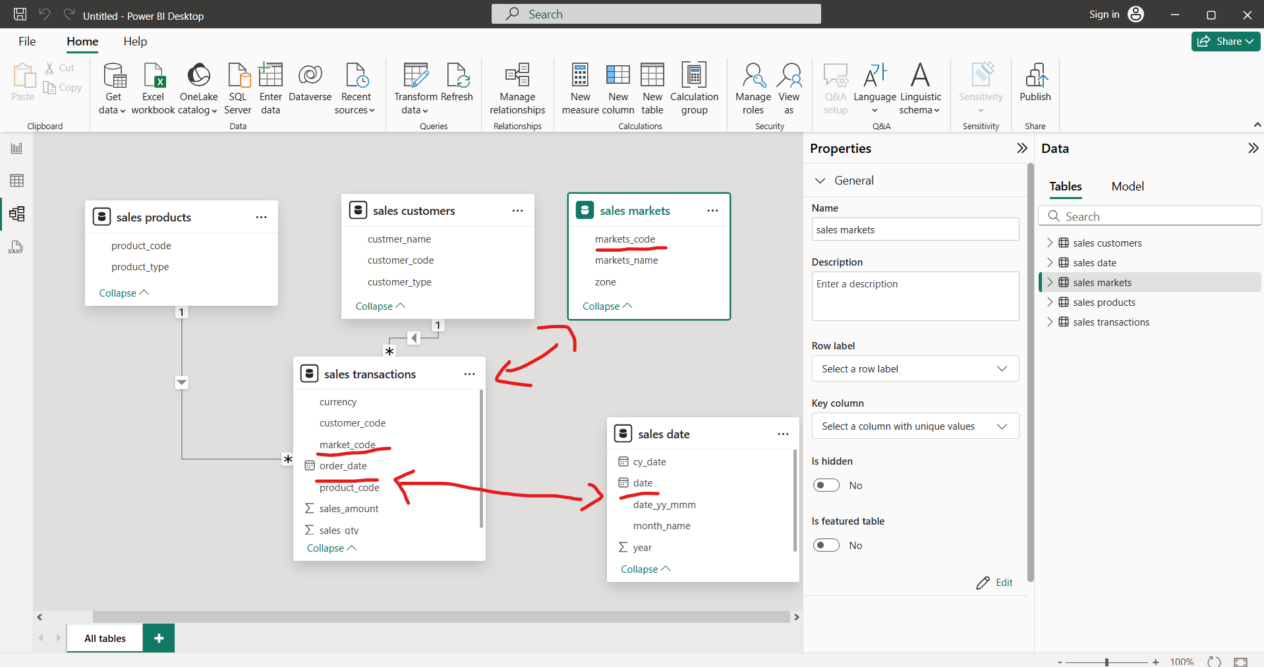
Manually make a relation based on Common columns→ b/w table “sales transactions and sales markets” Similarly “sales transaction and sales date
Drag and drop column “markets_ code” to main table “sales transaction ”
Drag and drop column “date” to main table “sales transactions”
This becomes STAR SCHEMA
i-e Fact table(actual execution happening) and dimension table

Slide 12
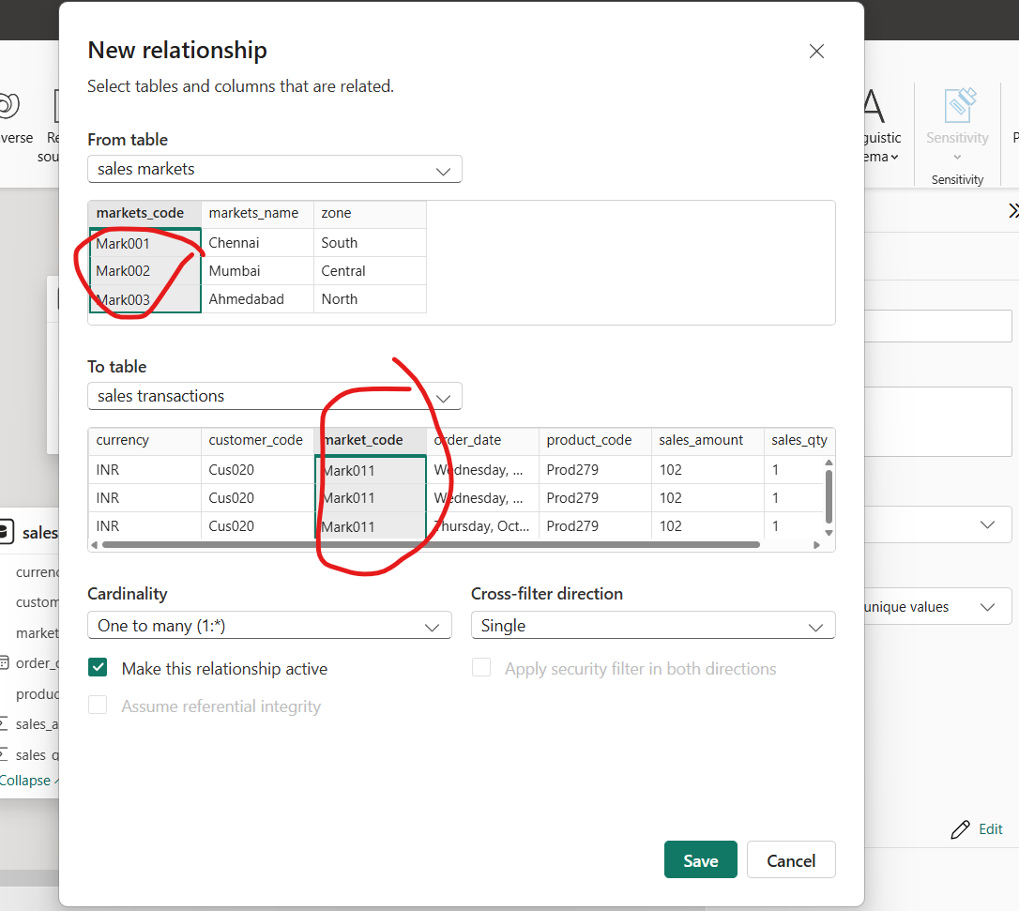
Relationship
This POP UP window would identify common occurrences and make a relationship based no those common occurrences
Click on save button

Slide 13
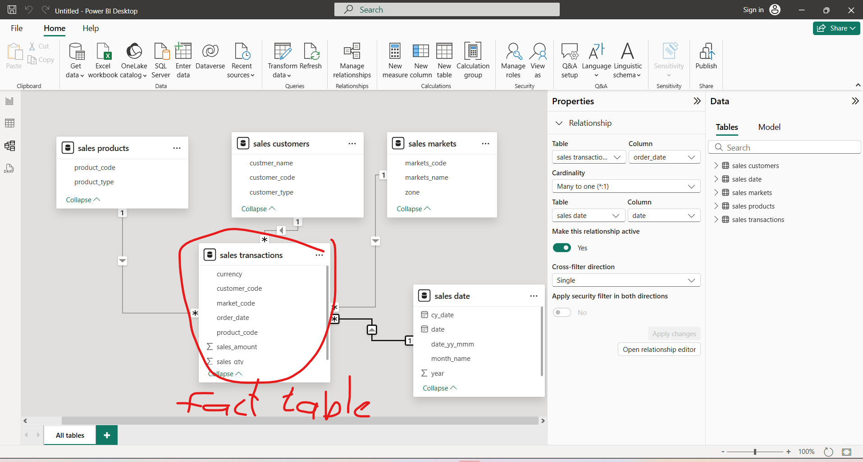
Star schema (Fact table having multiple dimensions)
Sales transactions would serve as the fact table, connecting all related tables through a common column (e.g., 'Transaction_ID') or different columns with overlapping values (e.g., ‘Order_date' in the “sales transactions” table and ‘date' in the “sales date” table).

Slide 14
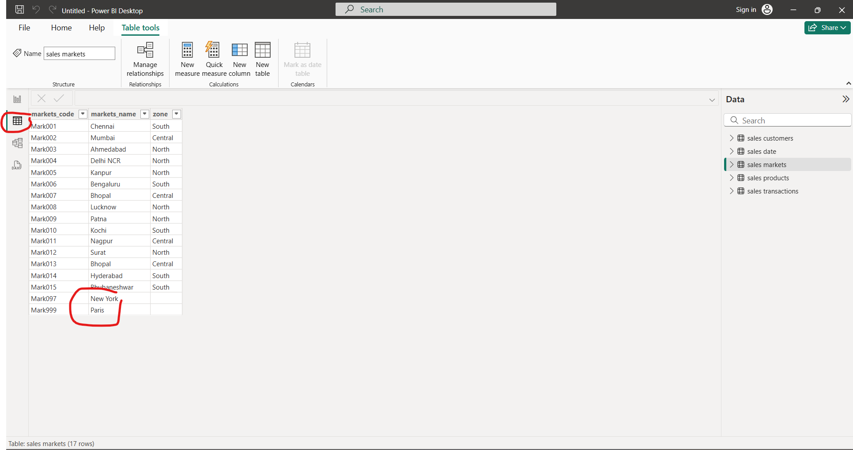
Goto tabular view and You want to filter newyork and paris in a table “sales Markets”

Slide 15
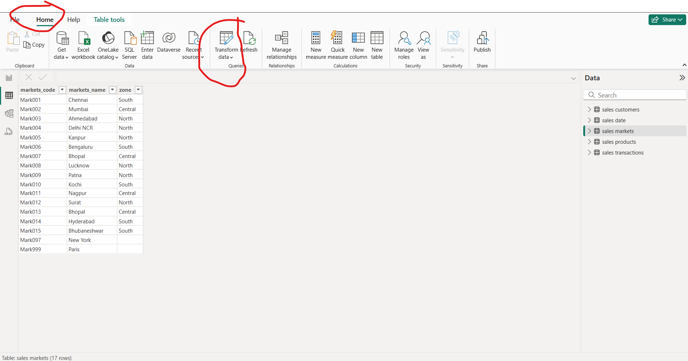
Goto home and Click on transform data

Slide 16
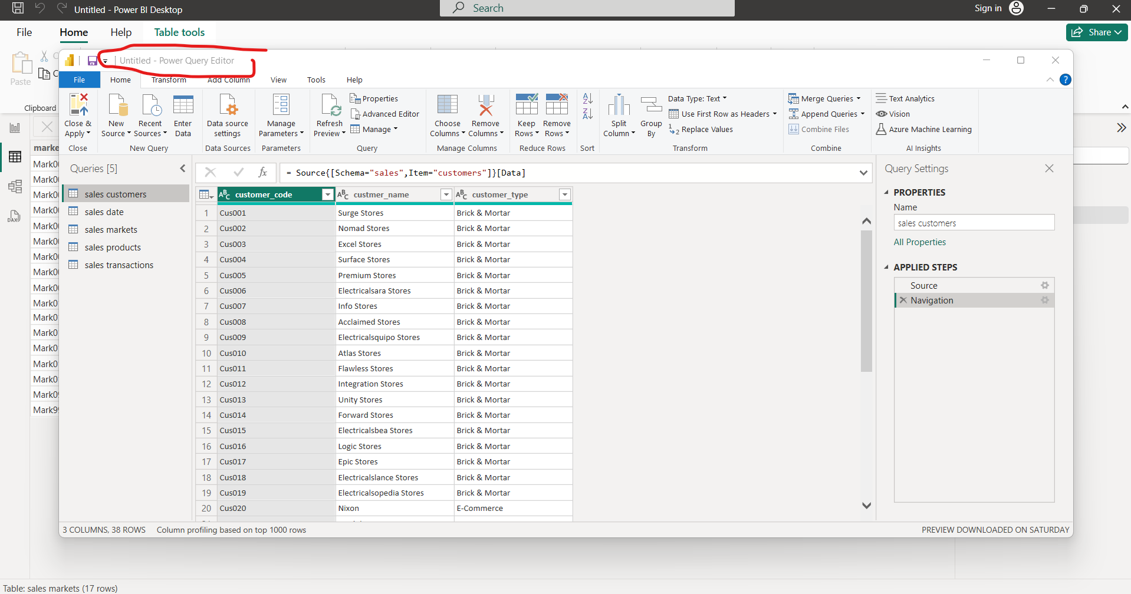
Power Query editor would be opened for all data cleaning, data wrangling and data transformations

Slide 17
Power BI is nothing but excel on steroid :D

Slide 18
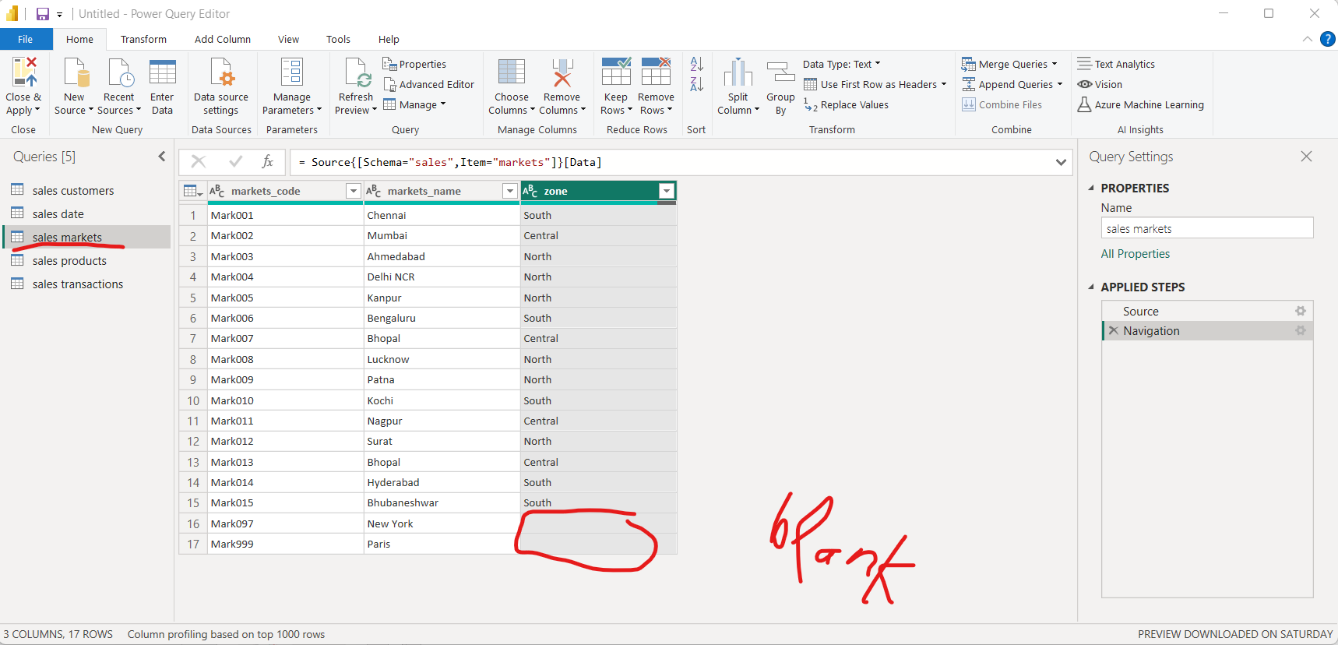
Here you see blank values

Slide 19
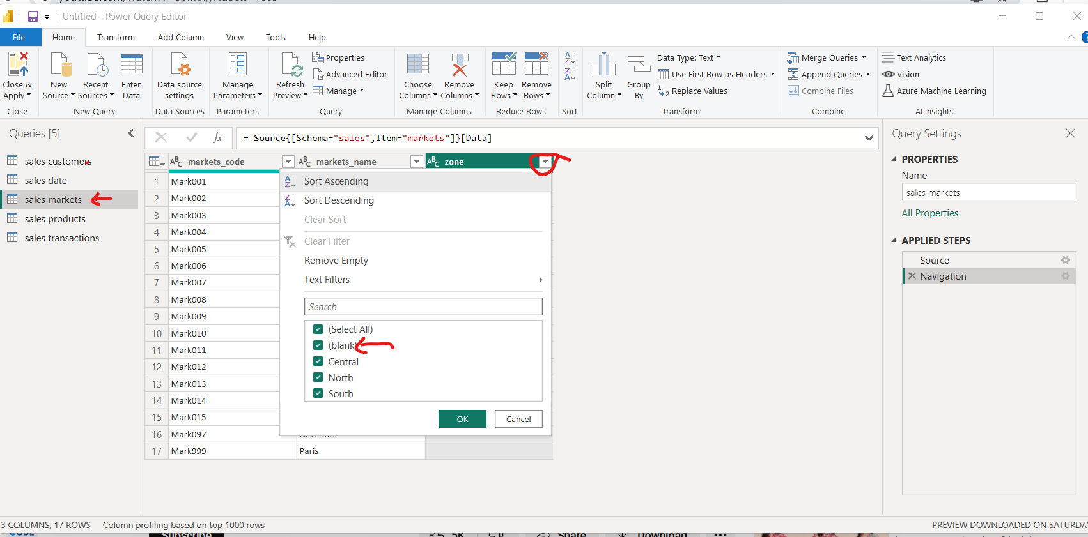
Select all except blank and click Ok -> your blanks values would be gone

Slide 20
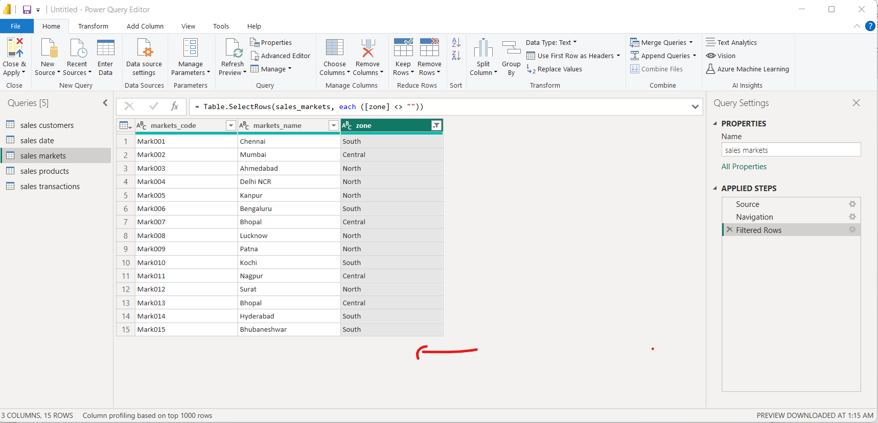
Gone are all the blank values

Slide 21
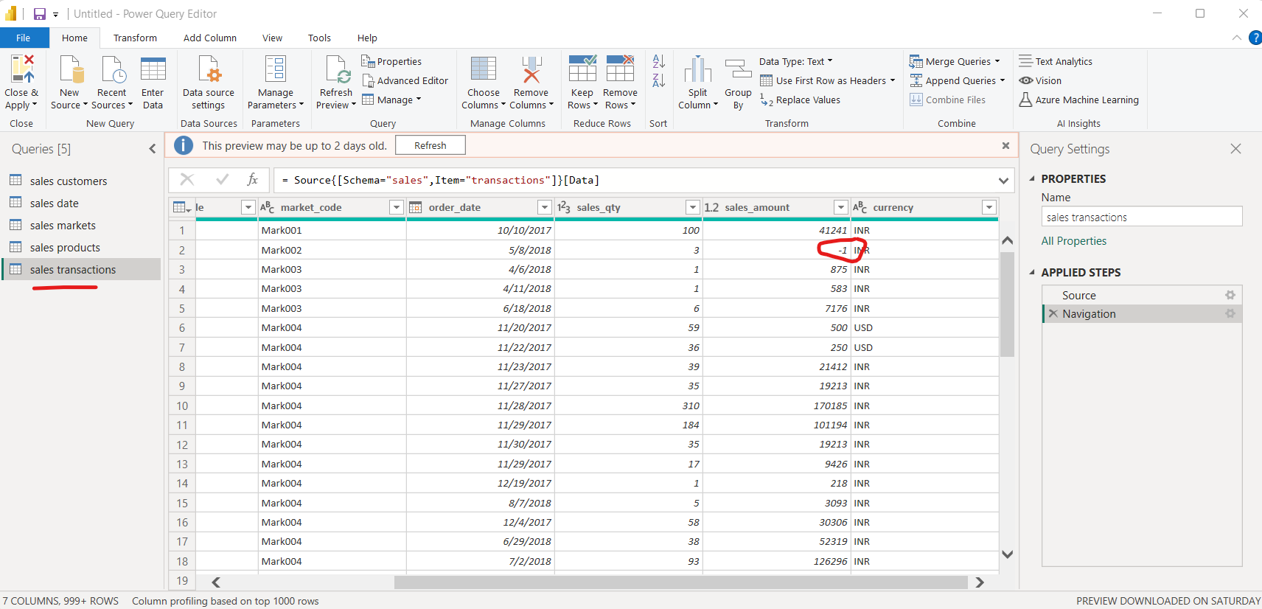
You find another value -1 in sales amount column of sales transactions table

Slide 22
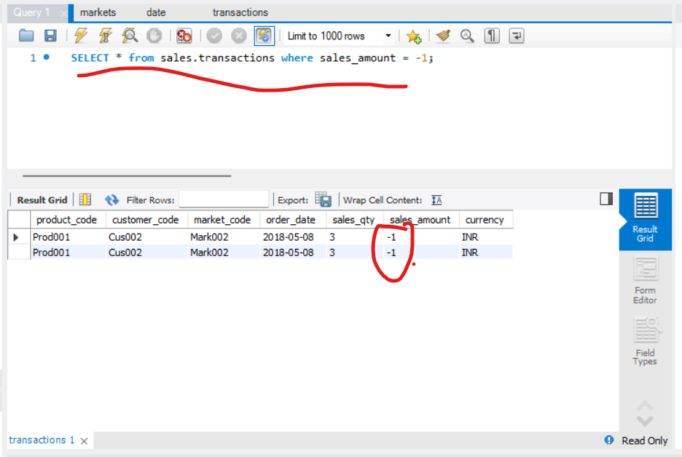
To find many values of sales_amount column to -1, goto Microsoft workbench and write this query
SELECT * from sales.transactions where sales_amount = -1;

Slide 23
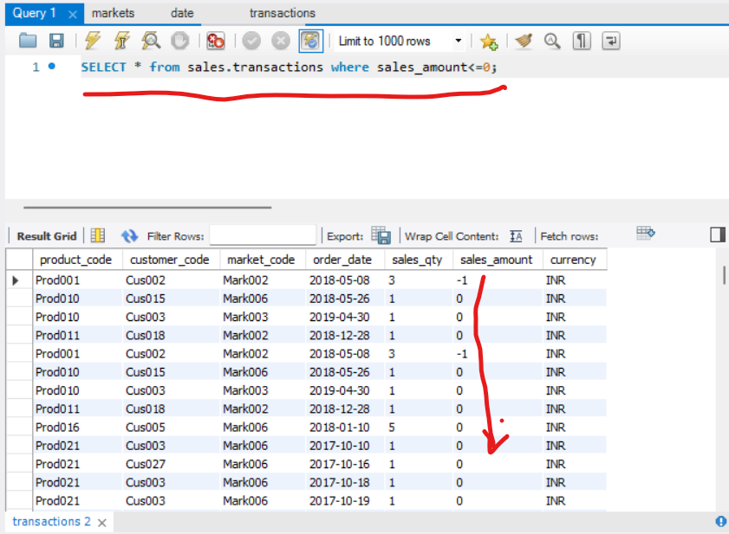
You can extract more garbage values lets write query
SELECT * from sales.transactions where sales_amount<=0;

Slide 24
Are all zeros garbage??
Yes all zeros are garbage if you see sales quantity is mentioned them how come sales amount is zero?

Slide 25
To clean all -1 and zero values we will go back to power Query window of power BI

Slide 26
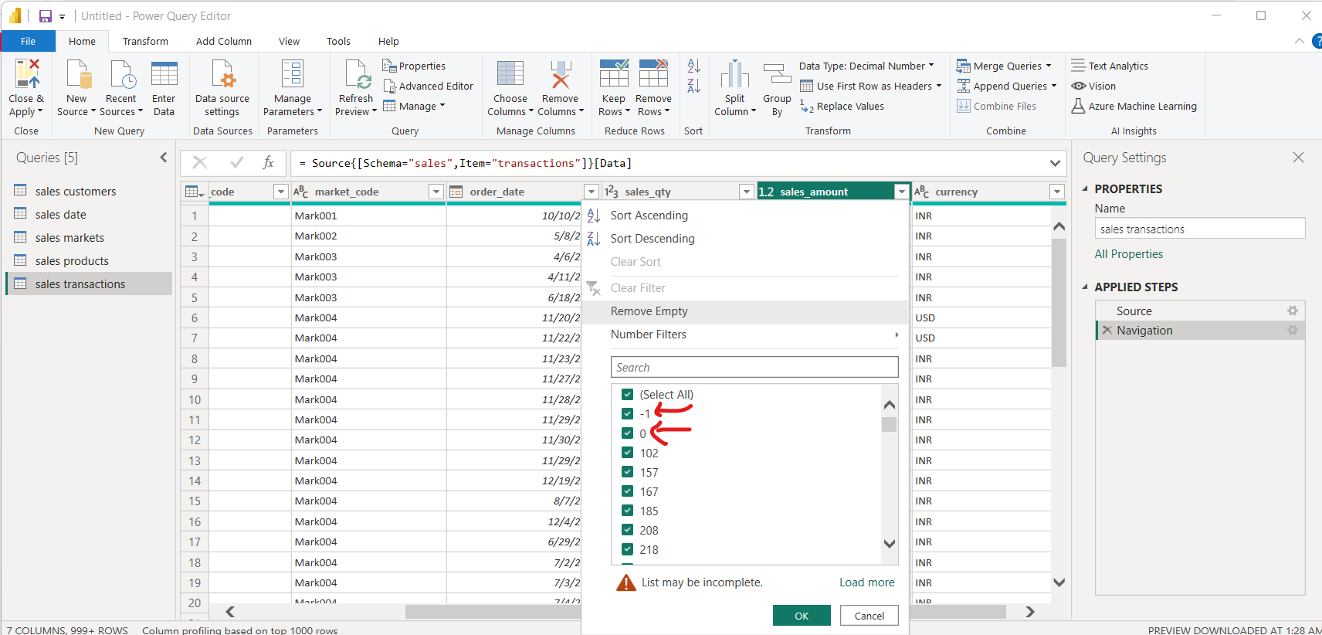
Goto sales_ amount drop down and uncheck -1 and zero to filter these values since they are garbage

Slide 27
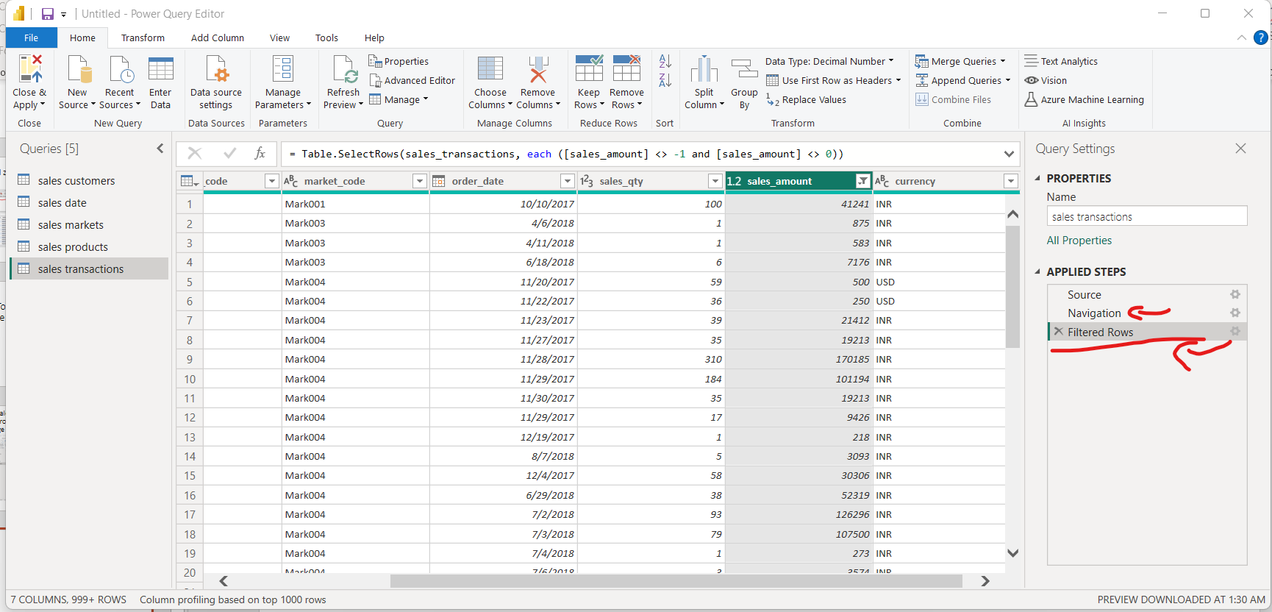
The values would be clean and a history would be maintained at the side panel of watever transformations have done uptil now

Slide 28
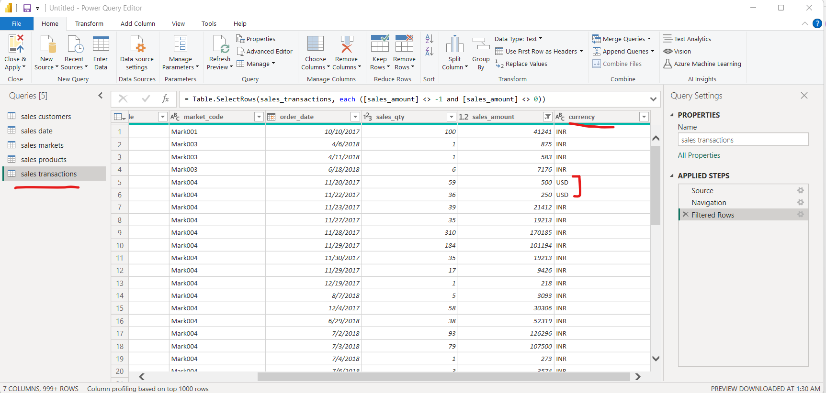
Now you want to convert USD into INR i-e Indian rupees. Cuz when you do sum of entire sales amount you can get dollar amount intermixed with Indian rupee

Slide 29
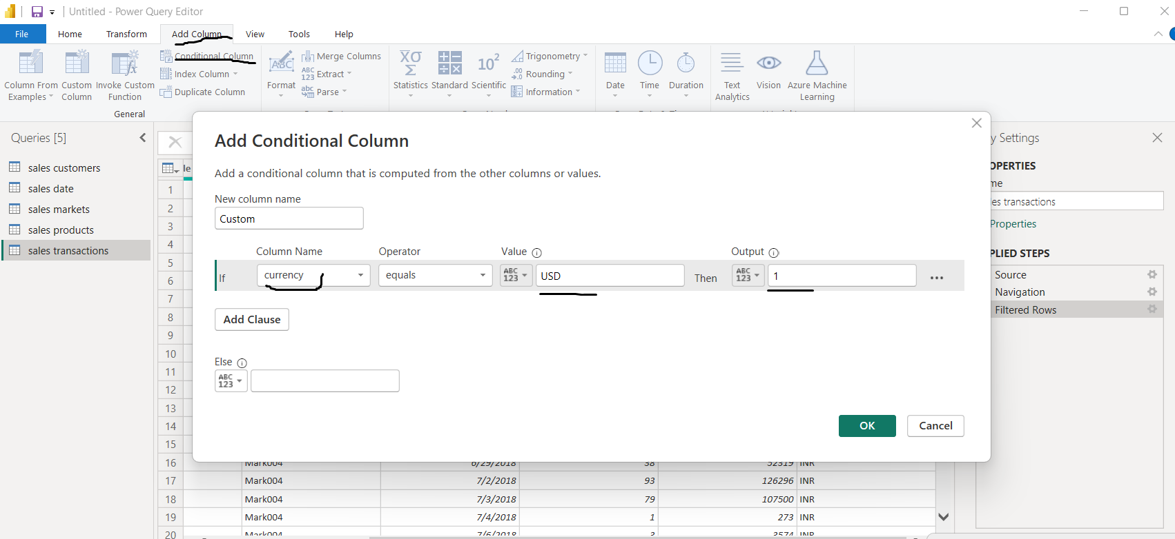
Click on Add Column then Conditional column and fill the form click ok

Slide 30
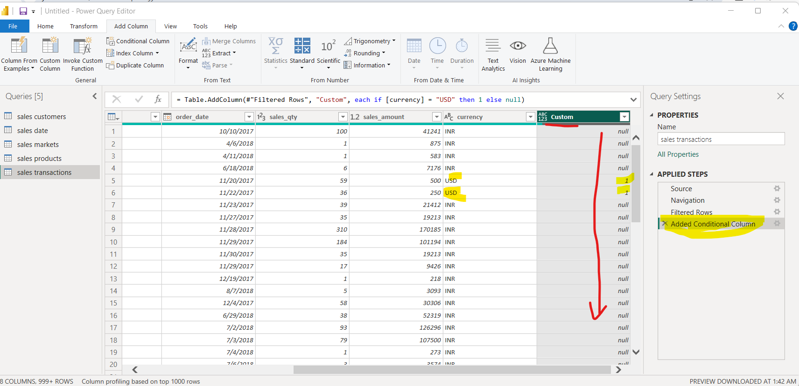
Your “custom” column is created asper conditions you set in the conditional form

Slide 31
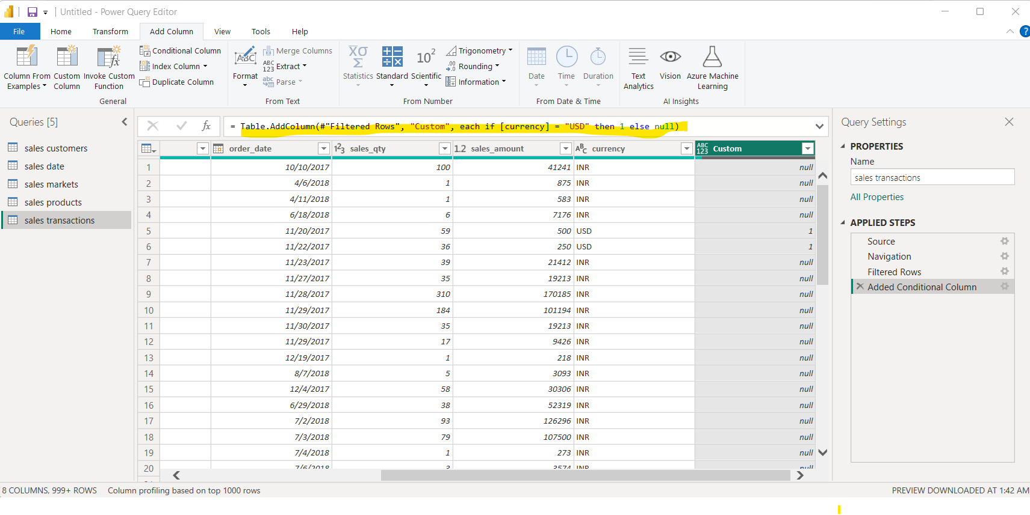
The formula is conveying similar in the formula bar
= Table.AddColumn(#"Filtered Rows", "Custom", each if [currency] = "USD" then 1 else null)

Slide 32
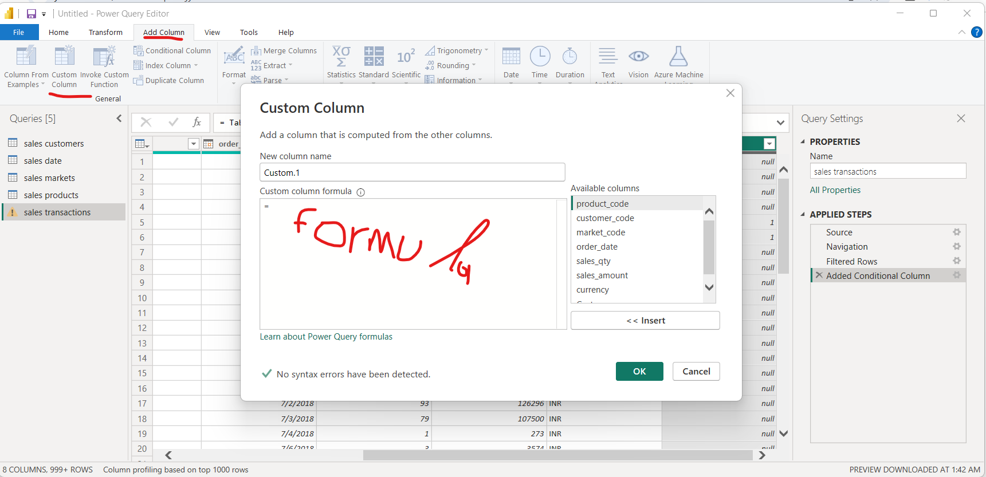
You can add custom clumn and edit formula and see result creating custom column

Slide 33
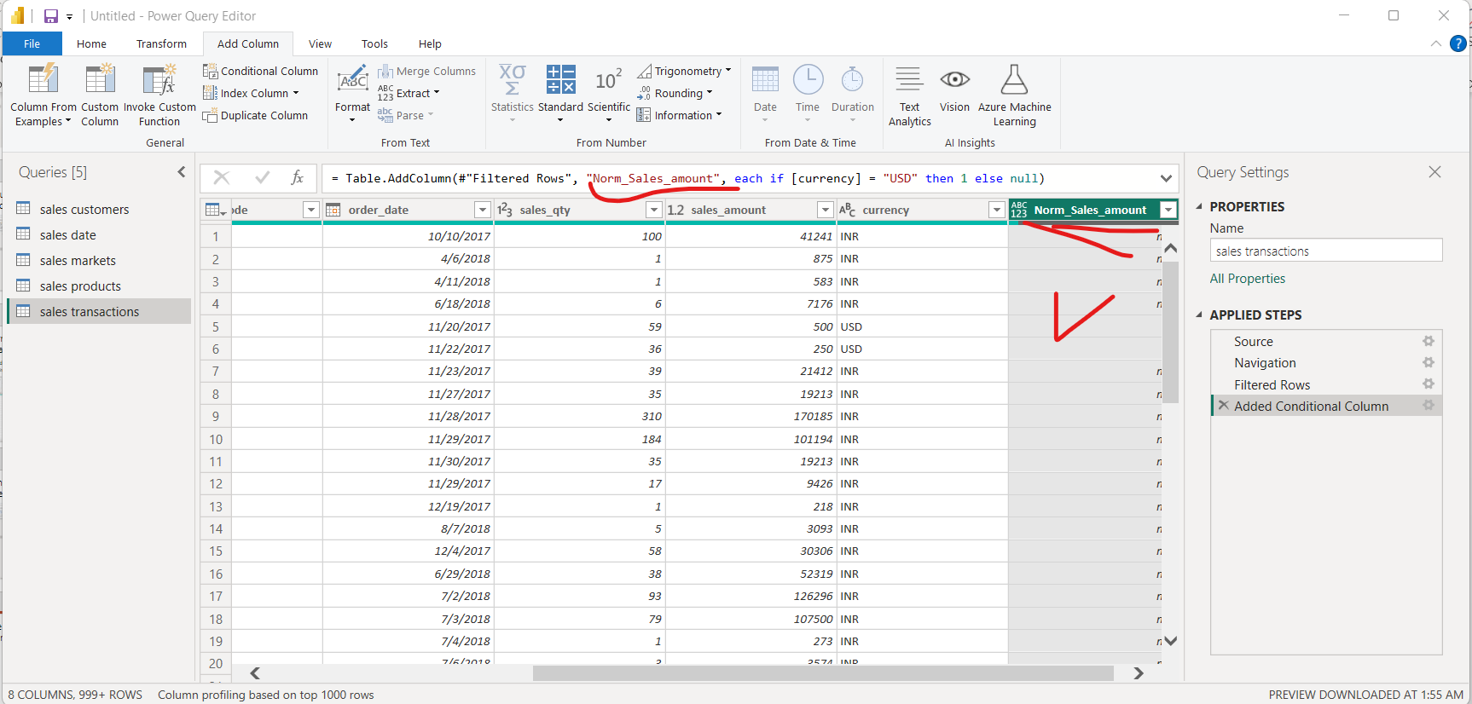
Change the name of the newly create colum into norm_sales_amount “= Table.AddColumn(#"Filtered Rows", "Norm_Sales_amount", each if [currency] = "USD" then 1 else null)”

Slide 34
Now apply formula to get the value Of INR money

Slide 35
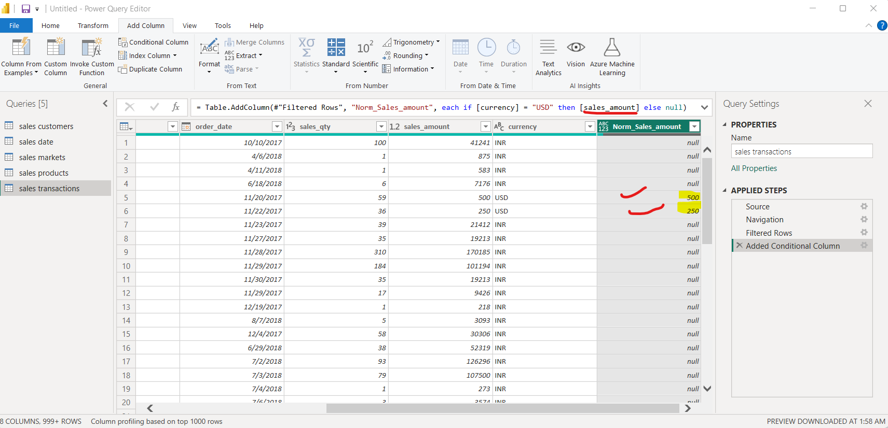

Slide 36
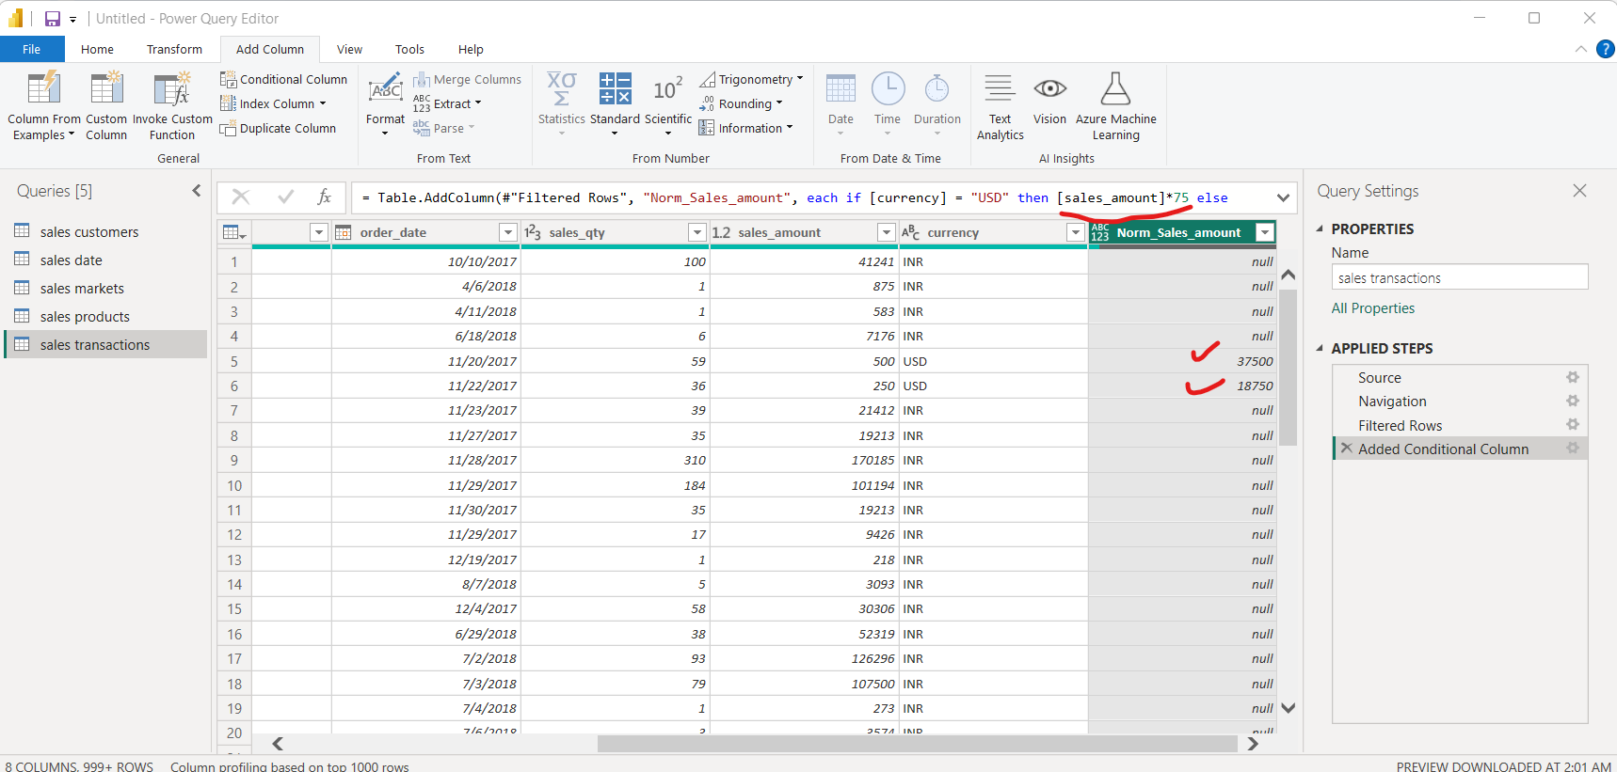
For example 1 USD = 75 INR so multiply sales_amount to 75 -> your USD currency would be convertd to INR

Slide 37
Remove rest of Null values to Indian rupees

Slide 38
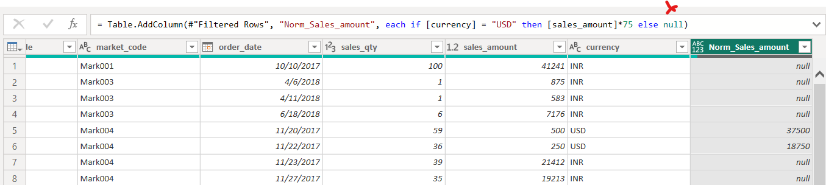
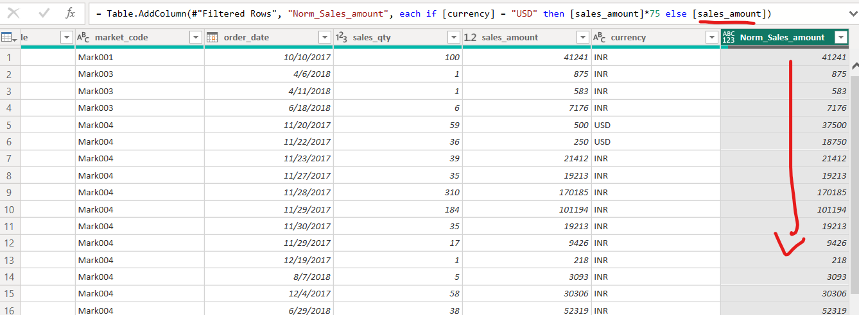

Slide 39
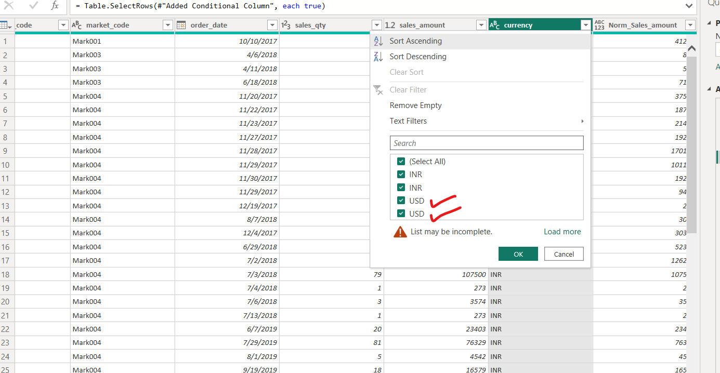
There can be more than one USD fields so you can check by viewing all only USD fields for that uncheck INR so only USD fields are visible

Slide 40
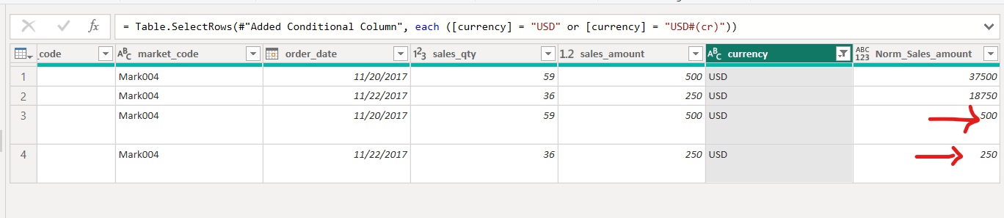
Here transformation wasn’t applying for converting INR into USD
WHY??

Slide 41
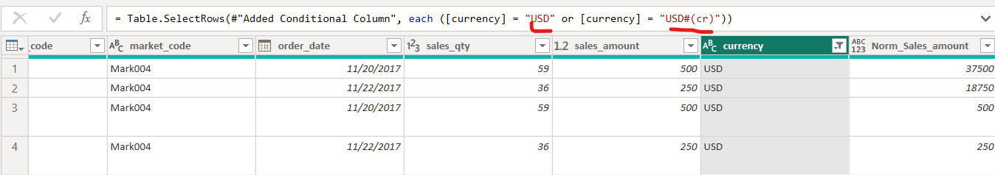
Because there is another type of USD called “USD#(cr)” So we need to edit the formula

Slide 42
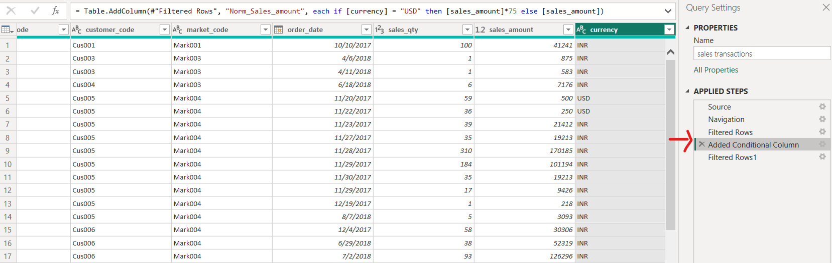
GOTO “ADDED CONDTIONAL column” in applied steps window and re-edit the formula

Slide 43
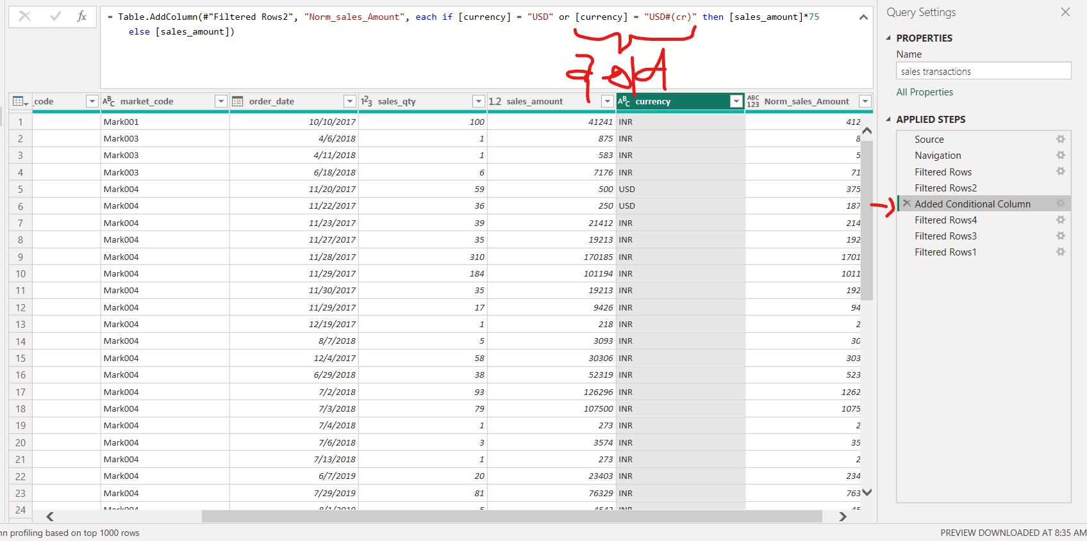
Add additional clause to the if statement

Slide 44
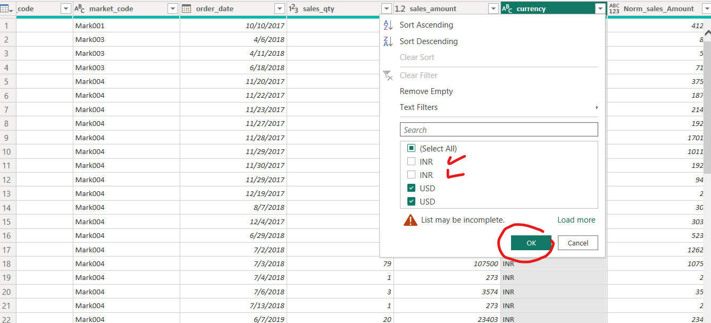
Again Uncheck and filter out the values of INR

Slide 45
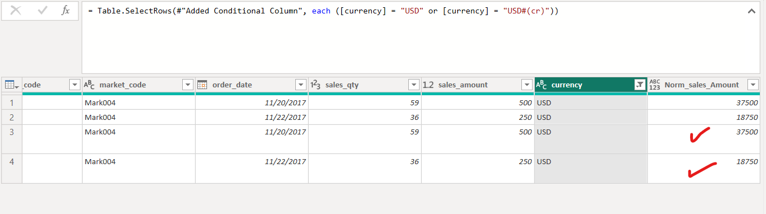
All USD values are converted to INR now

Slide 46
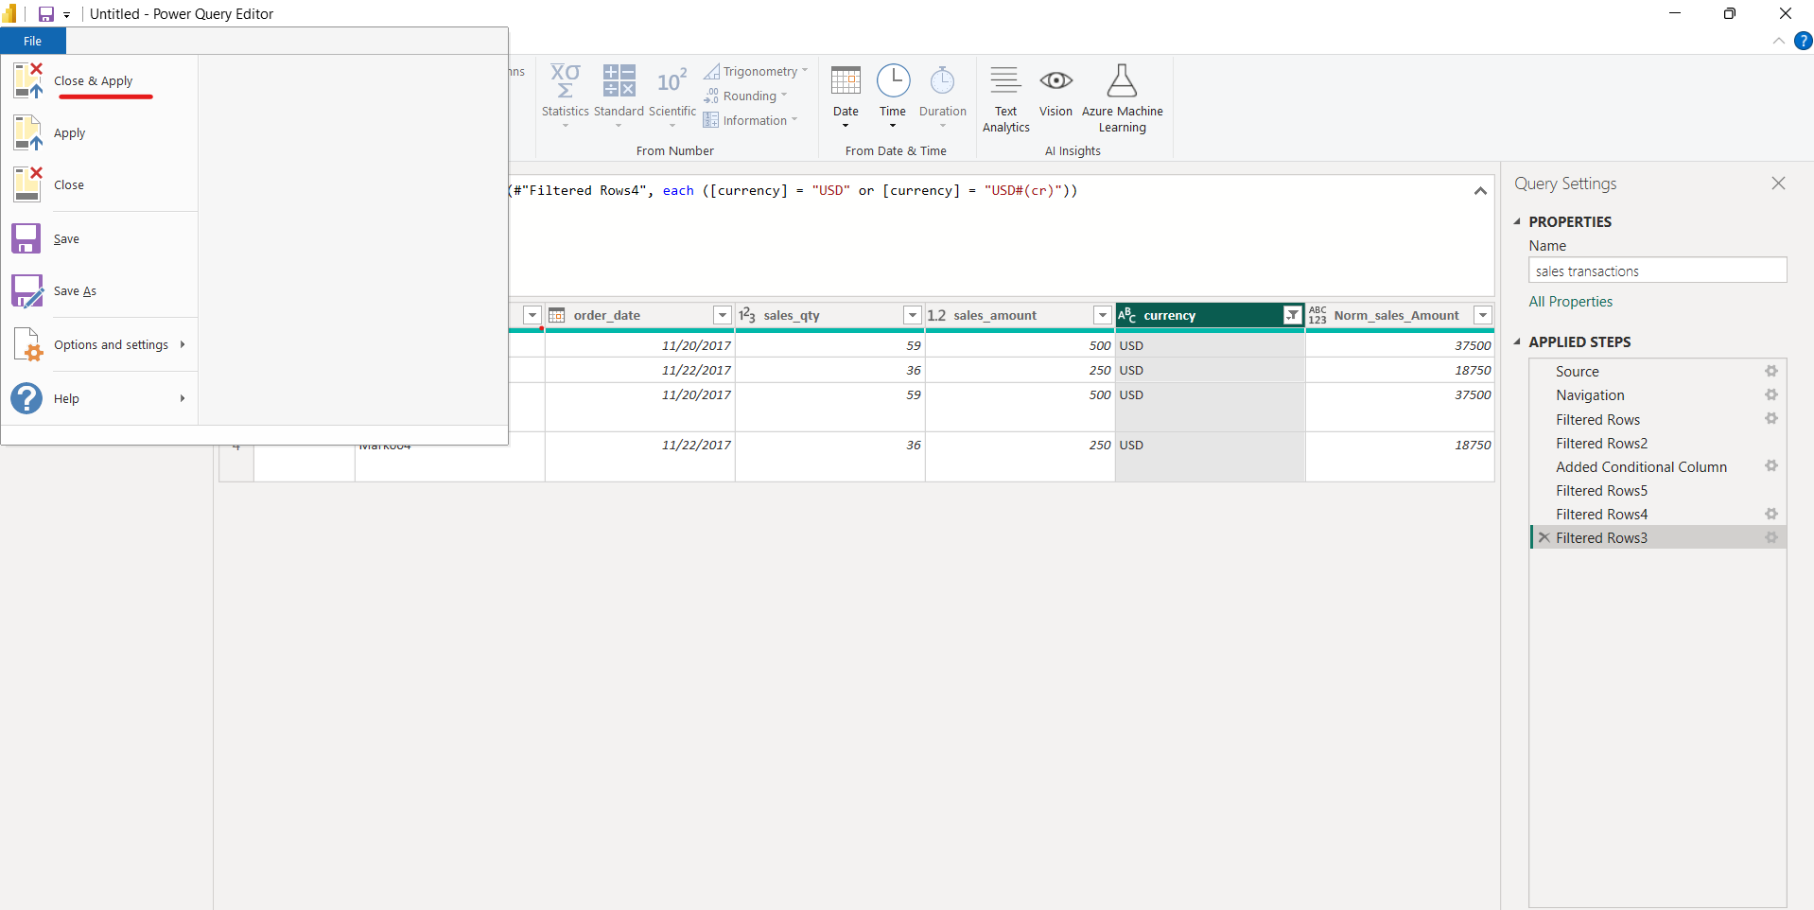
Close and Apply to save changes

Slide 47
Since there is a multiple occurrences of a currency we need to check that using Mysql Work Bench

Slide 48
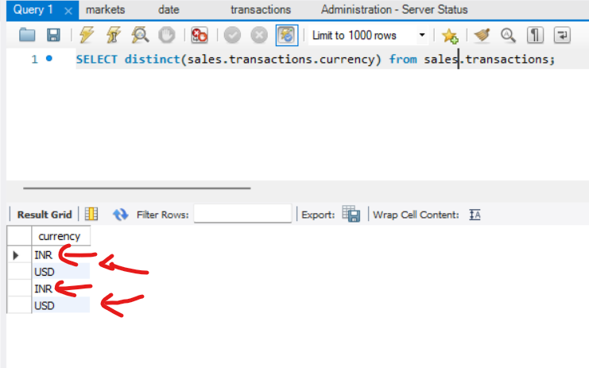
Duplicating occurrences

Slide 49
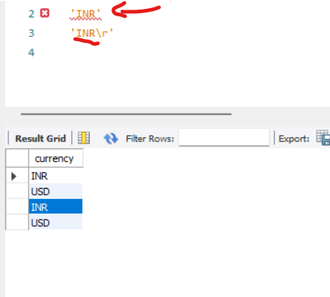
If you right click on “INR” in output screen and select copy row and paste over the query bar.
You will find different occurrences of “INR” and “INR\r”.
This might create problems in data analysis in future

Slide 50
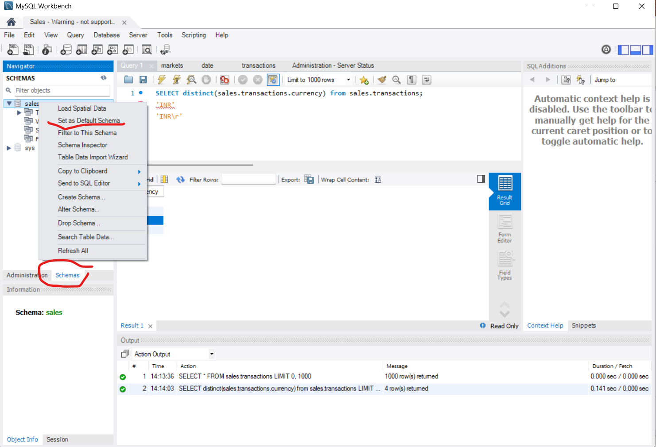
To avoid sales.transactions.currency and instead write transactions.currency
Goto “schema” tab
Right click on sales table

Slide 51
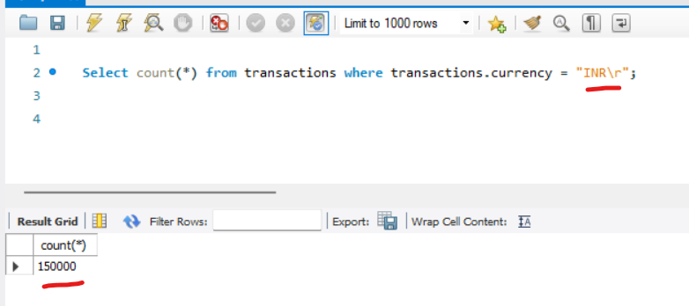
How many “INR\r” records in transactions table

Slide 52
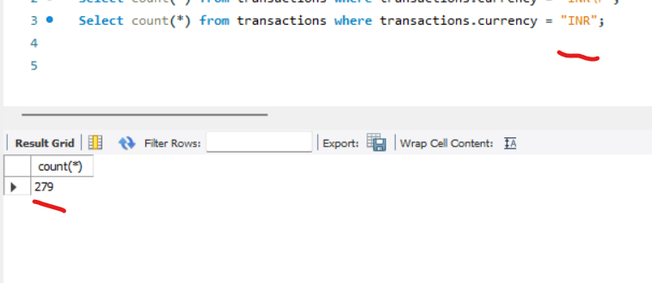
Now see: How many “INR” records in transactions table

Slide 53
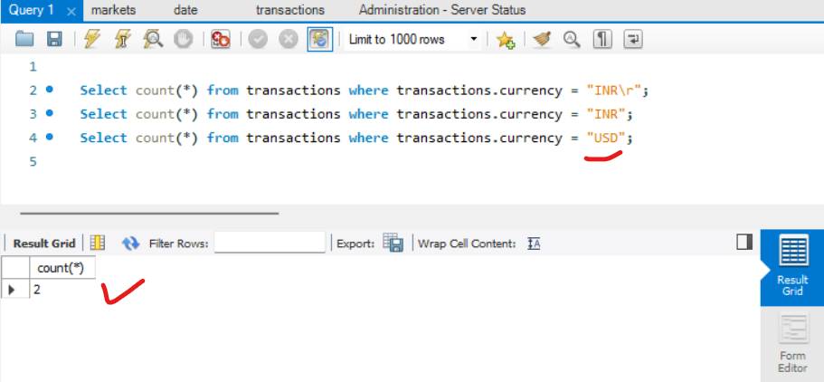
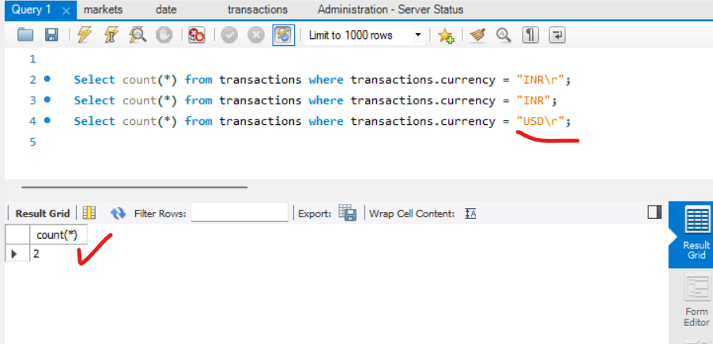
USD and USD\r have similar records

Slide 54
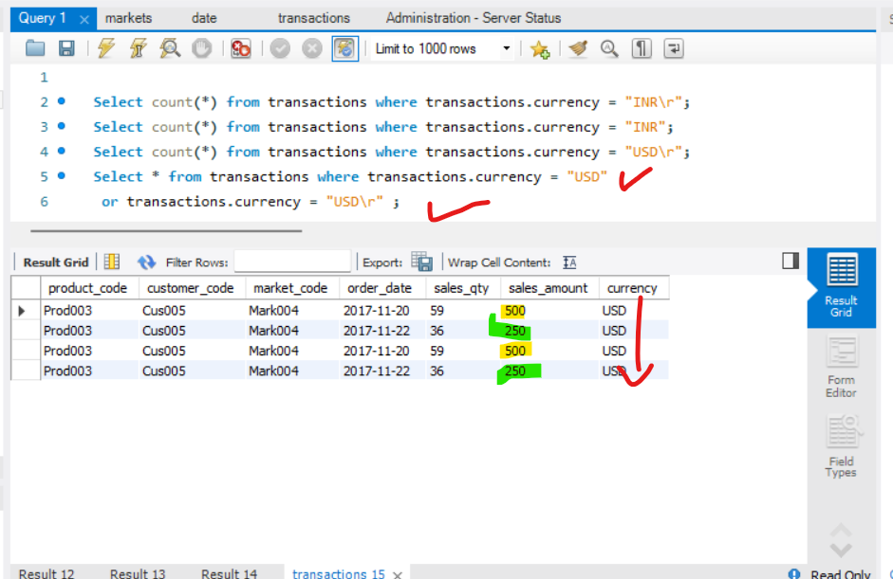
These records are indeed duplicate

Slide 55
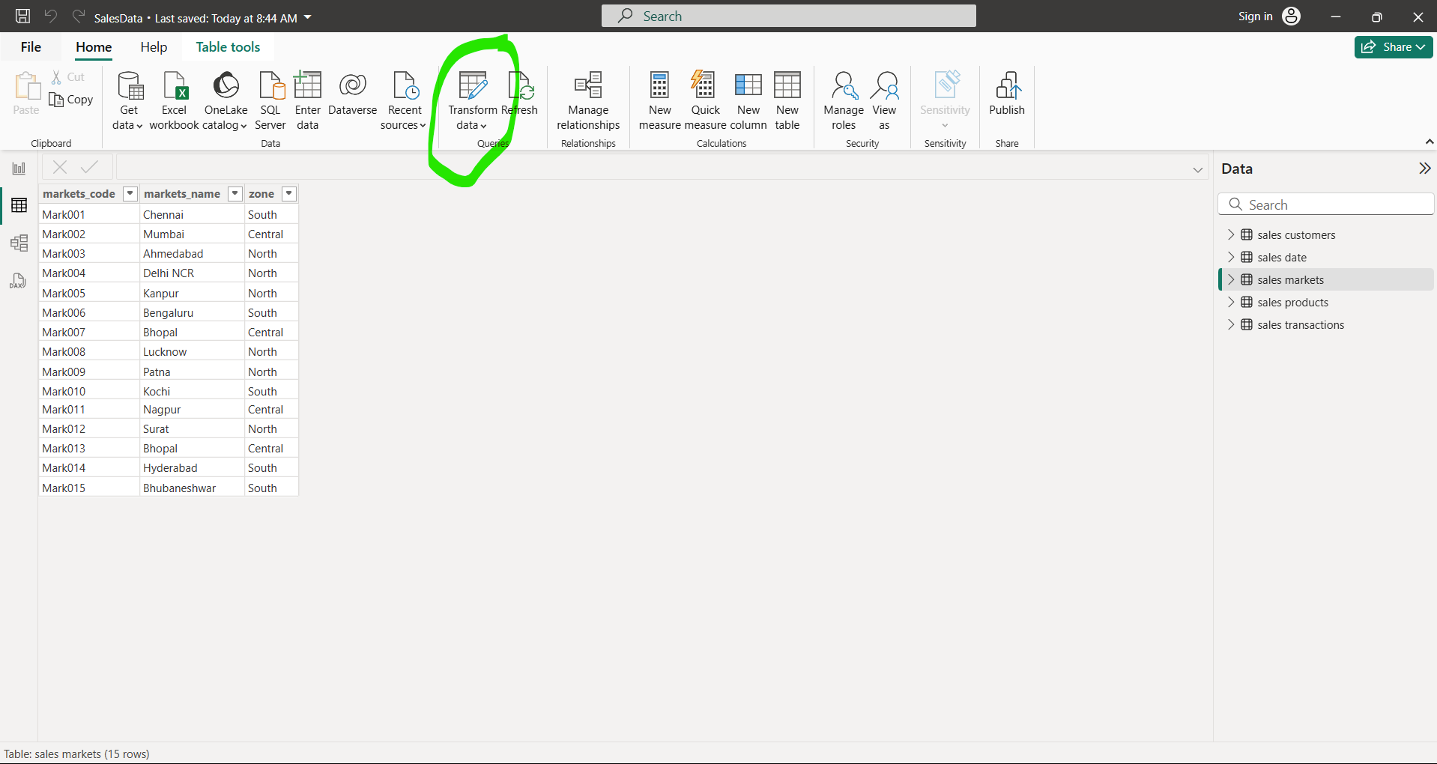
To address this issue we will not remove any records , goto power BI and click on transform data to launch power query editor

Slide 56
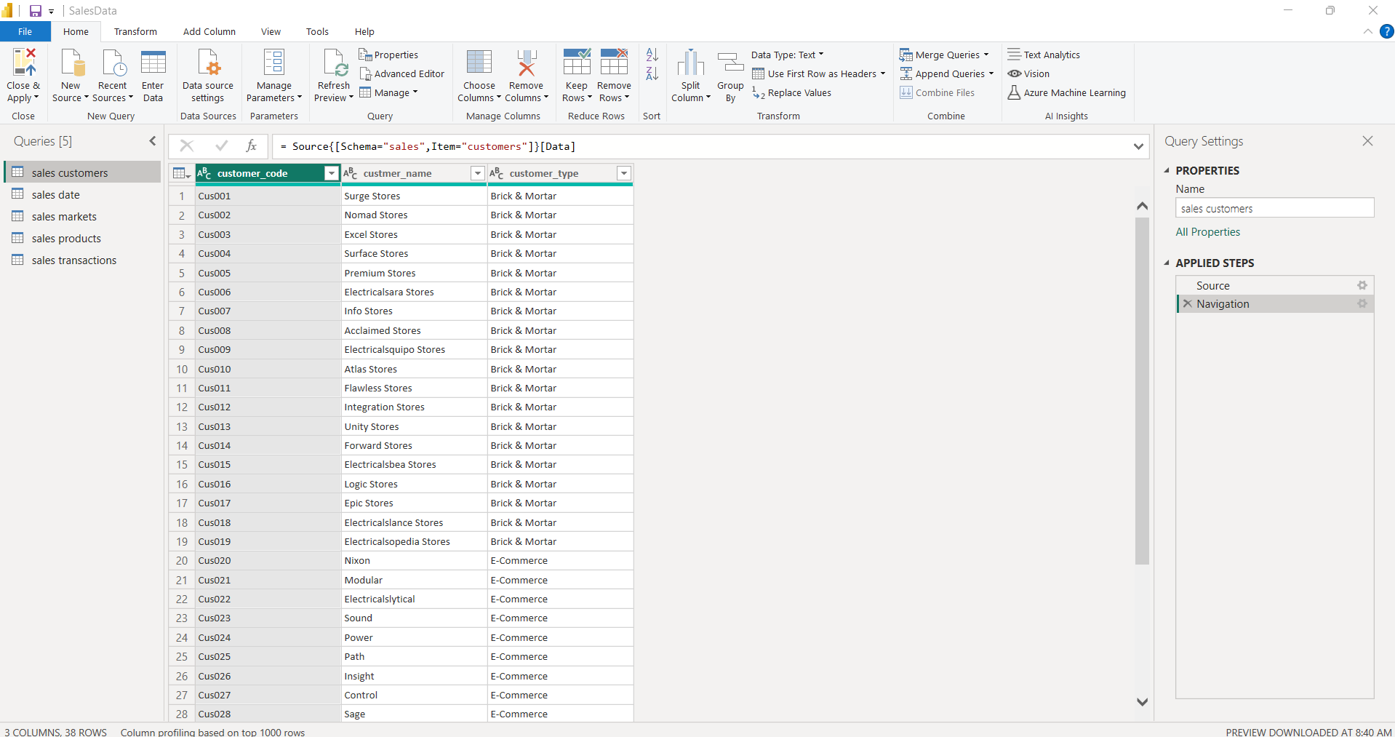
Power Query editor would be launched

Slide 57
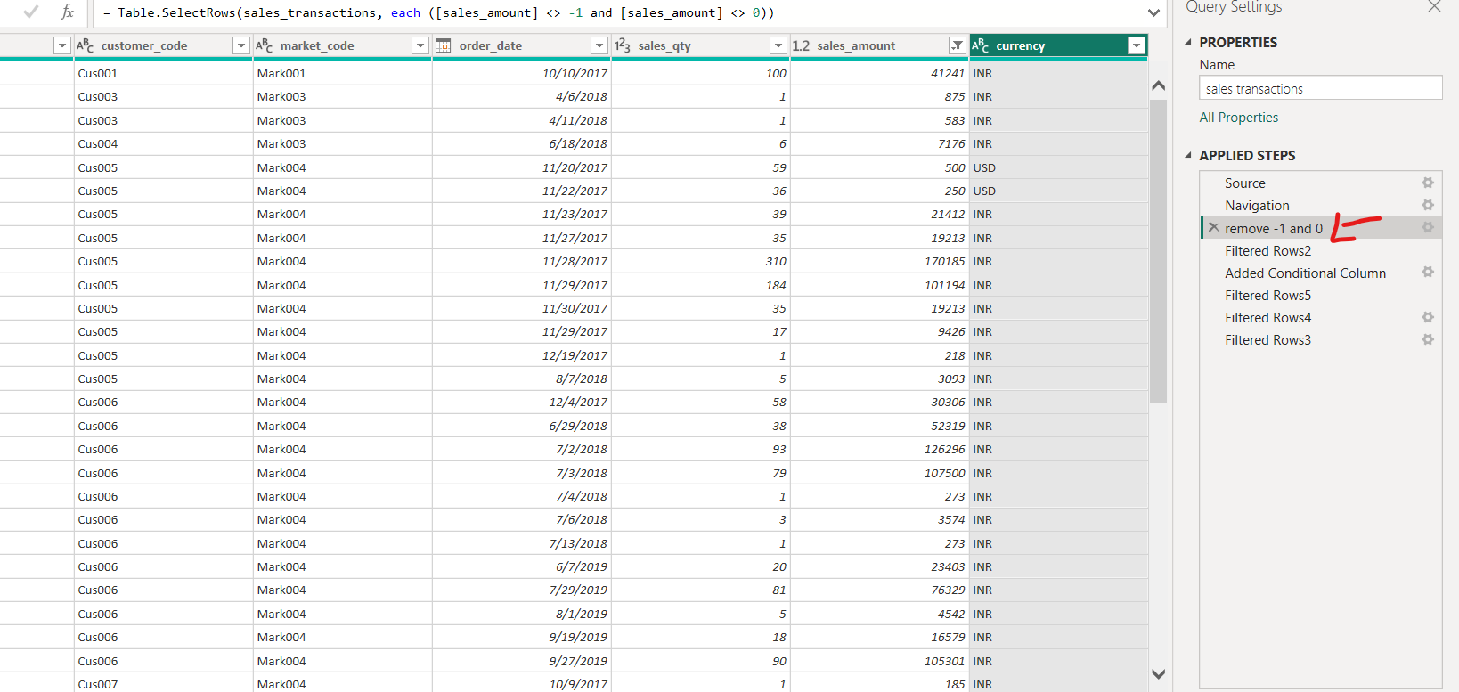
Rename the filtered row 1 -> remove -1 and 0

Slide 58

Click on the Currency drop down
As we found INR#(cr) has more records and similarly USD#(cr) has more valid record
INR#(cr) and USD#(cr) comprises of the second value in a screen shot showing on right
So we have filtered other INR and USD values to keep the INR#(cr) and USD#(cr)

Slide 59

Rename Filtered Row1-> INR#(cr) and USD#(cr)

Slide 60
You already took care of duplicating record based on Currency

Slide 61

Click on Close and Apply to save changes

